Slide 1

Teen Mental Health
Sidney Little

Slide 2

People often feel isolated.

Slide 3
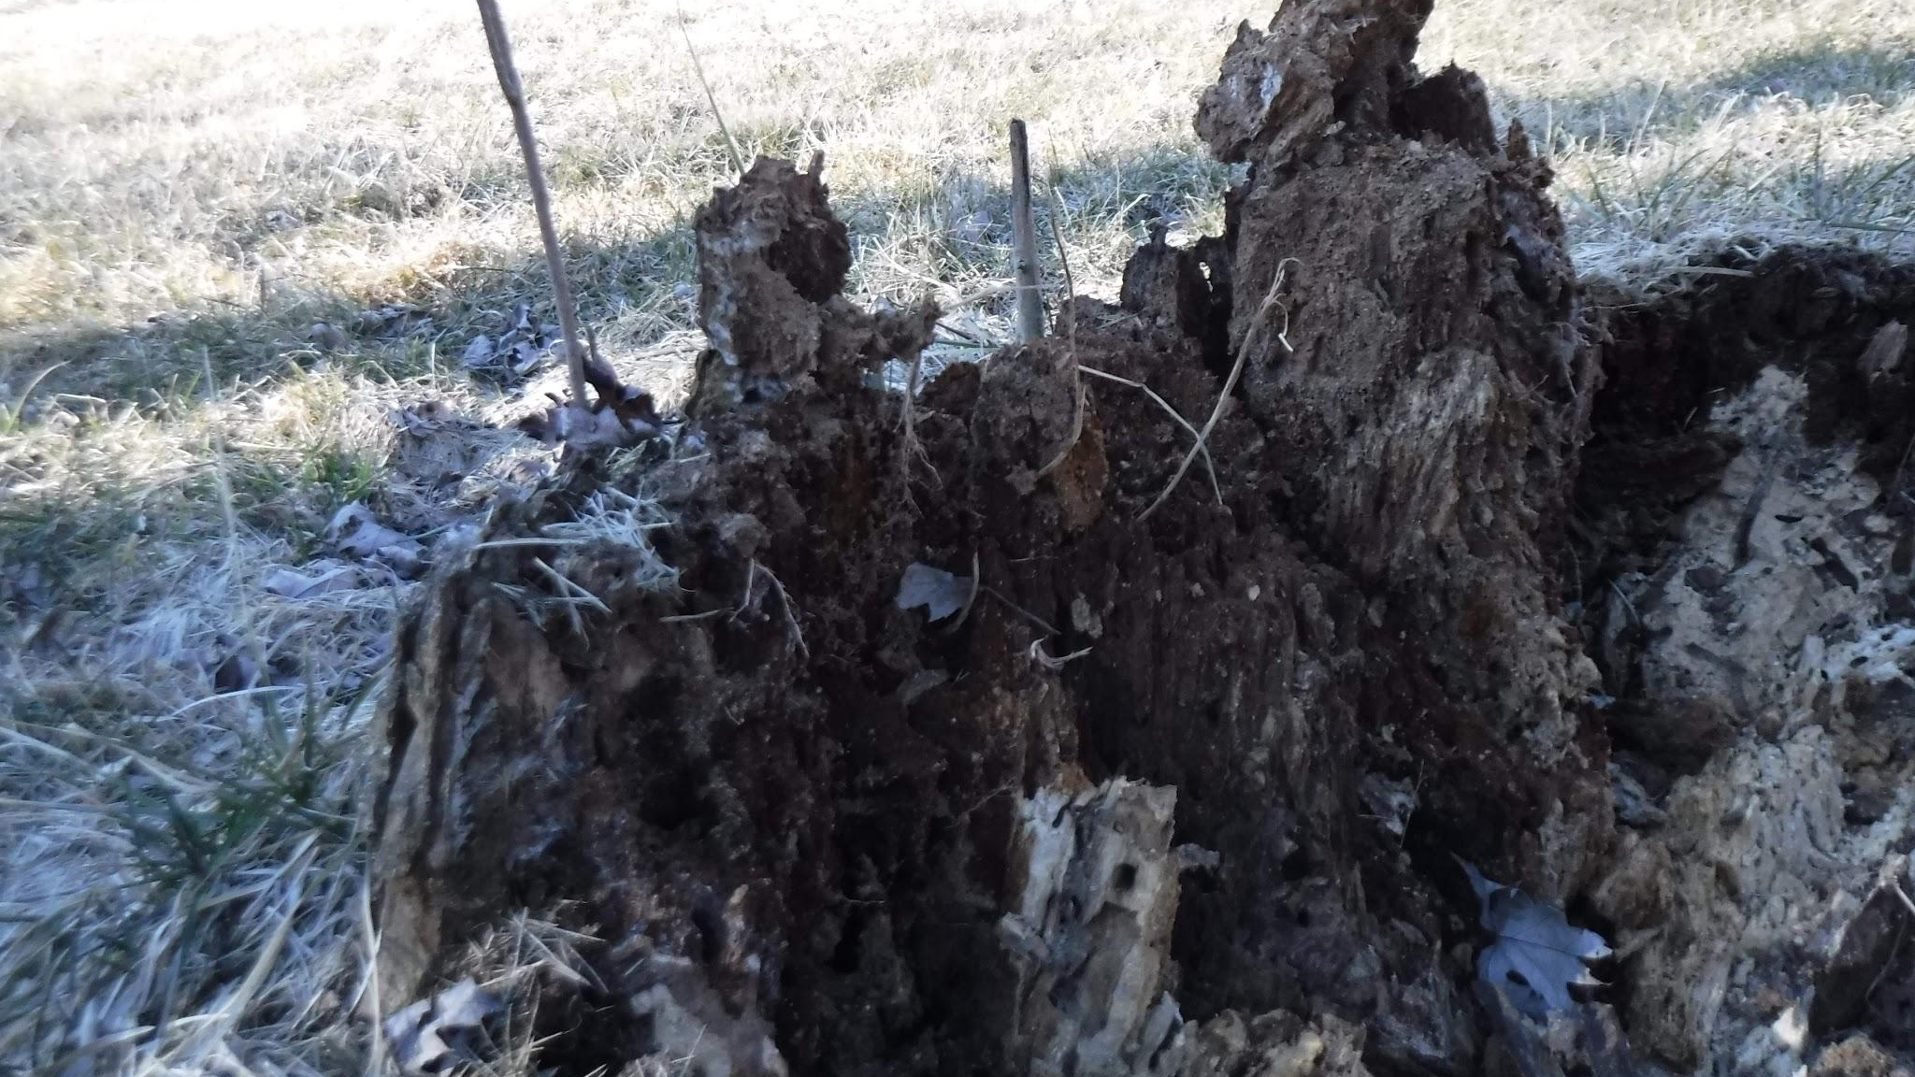
Many people’s mental states deteriorate over time.

Slide 4
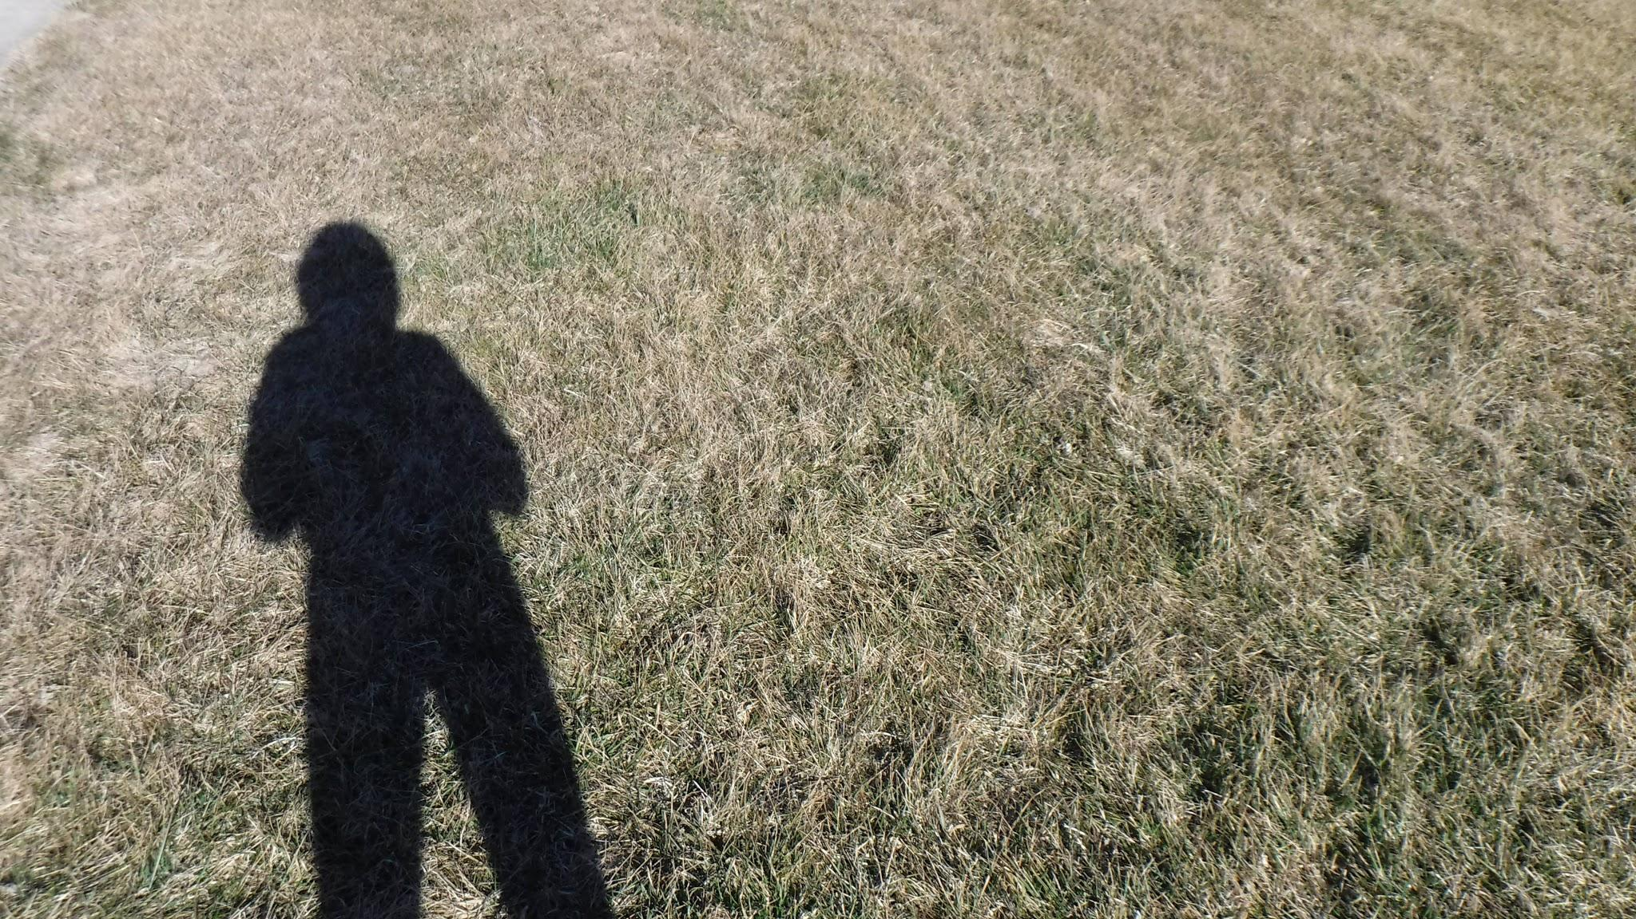
People are very dependent on others.

Slide 5
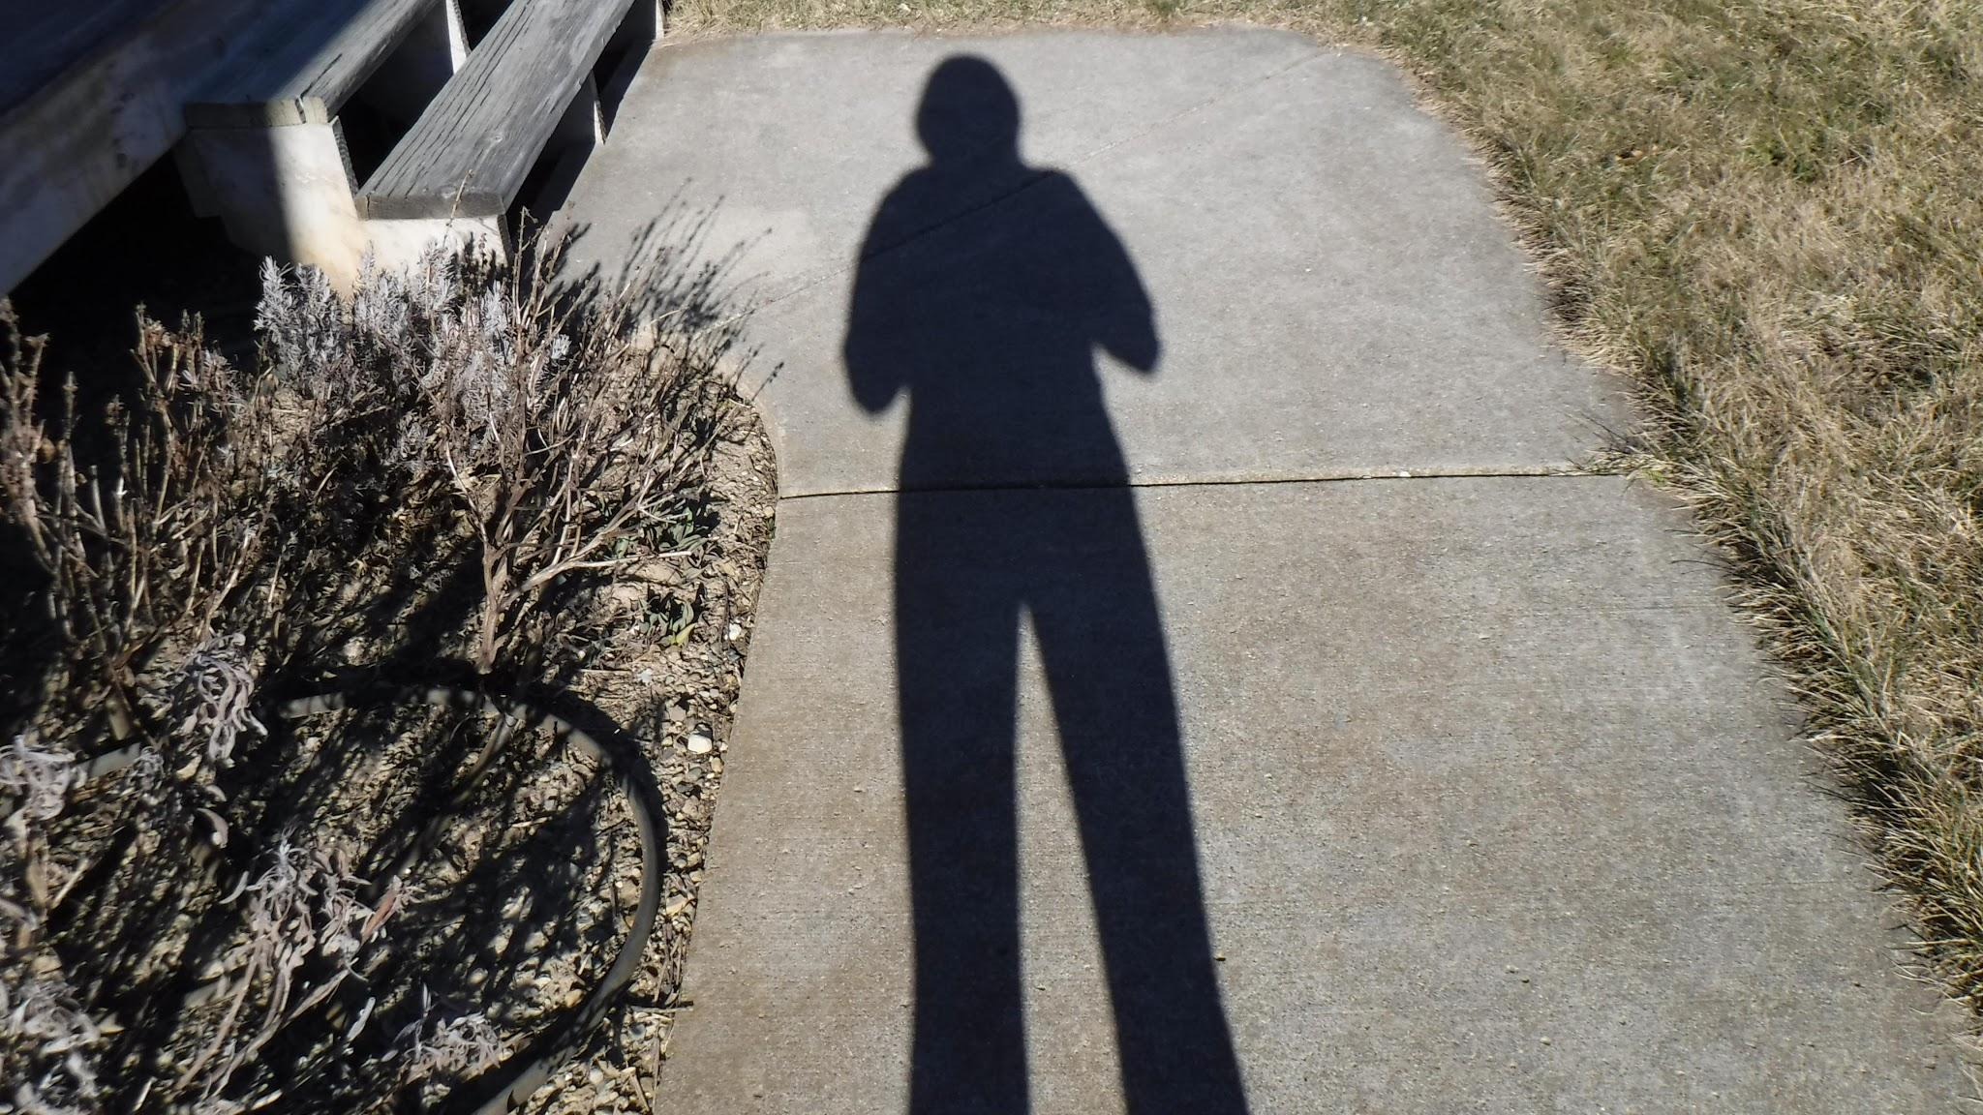
“Others” can include you.

Slide 6

People often continue feeling broken rather than getting help.

Slide 7

Many people feel broken all the time.

Slide 8
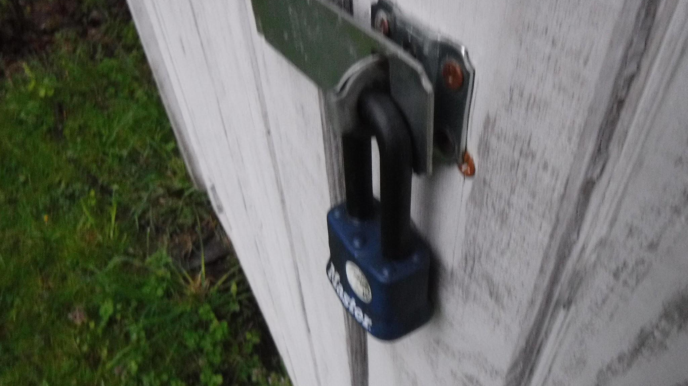
People often keep their emotions under lock and key.

Slide 9

Peoples emotions are delicate.

Slide 10
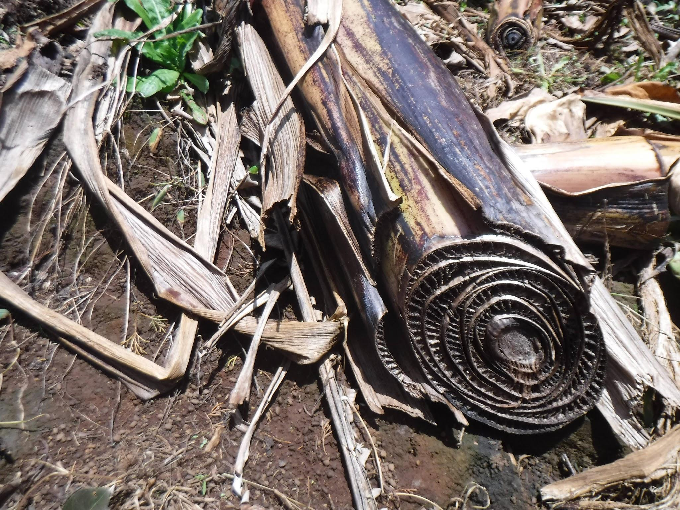
People have layers of emotion.

Slide 11

People’s insides are different than they appear.

Slide 12



The 4HChangemakers is a group of Washtenaw County students (ages 13-18) whose goal is to raise student awareness and help educate their peers about what they can do (for themselves and others) regarding youth mental health in their communities. The students have hosted education/outreach events and trainings.
Teens use digital storytelling to increase awareness and destigmatize mental health through social media and (now virtual) public exhibits. Local and online experts share knowledge of tools to help tell stories: photography, graphic arts, videography, podcasting, interview techniques, meme making, and more. The group continues to explore innovative ways to humanize stories and share information with their peers.
This 4H Changemakers 2020 Digital Exhibit – STOMP OUT STIGMA -
is made possible thanks to generous funding from 4H, Microsoft, and University of Michigan Community Health Services.
Contact Washtenaw County 4H for more information about this and other teen mental health initiatives at (734) 222-3900 https://www.canr.msu.edu/washtenaw/washtenaw_county_4_h/

